Slide 1
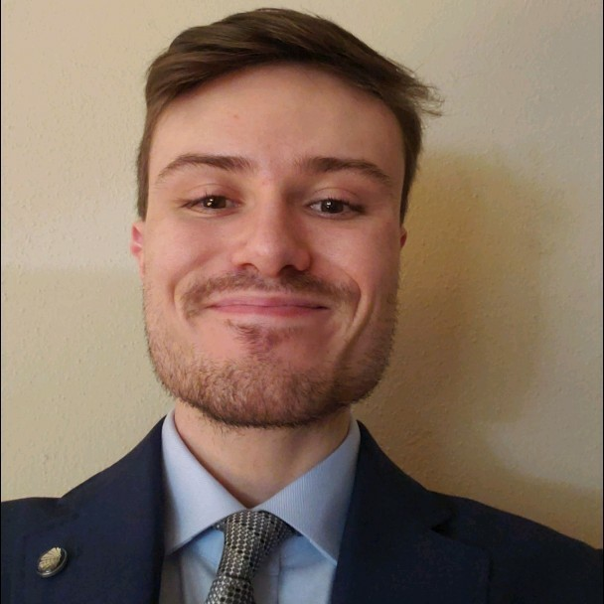

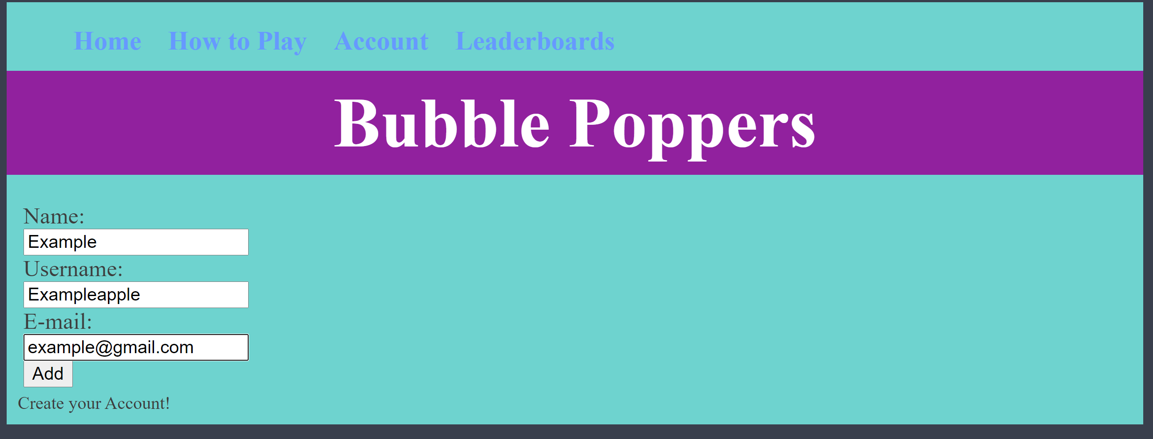
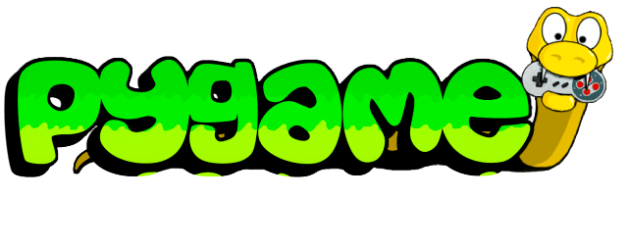
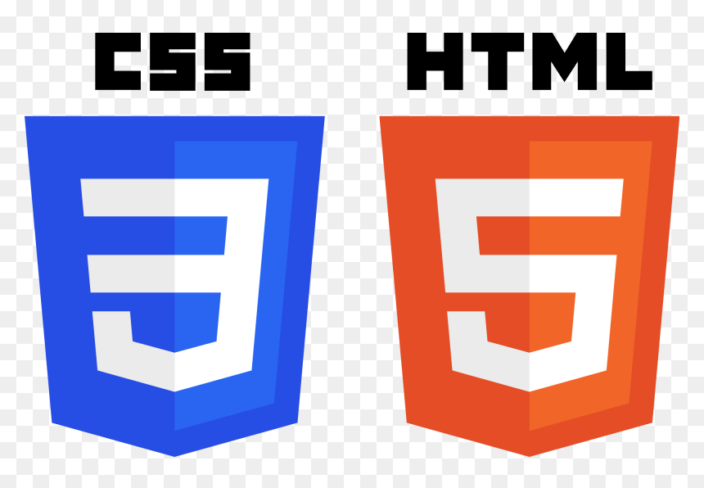
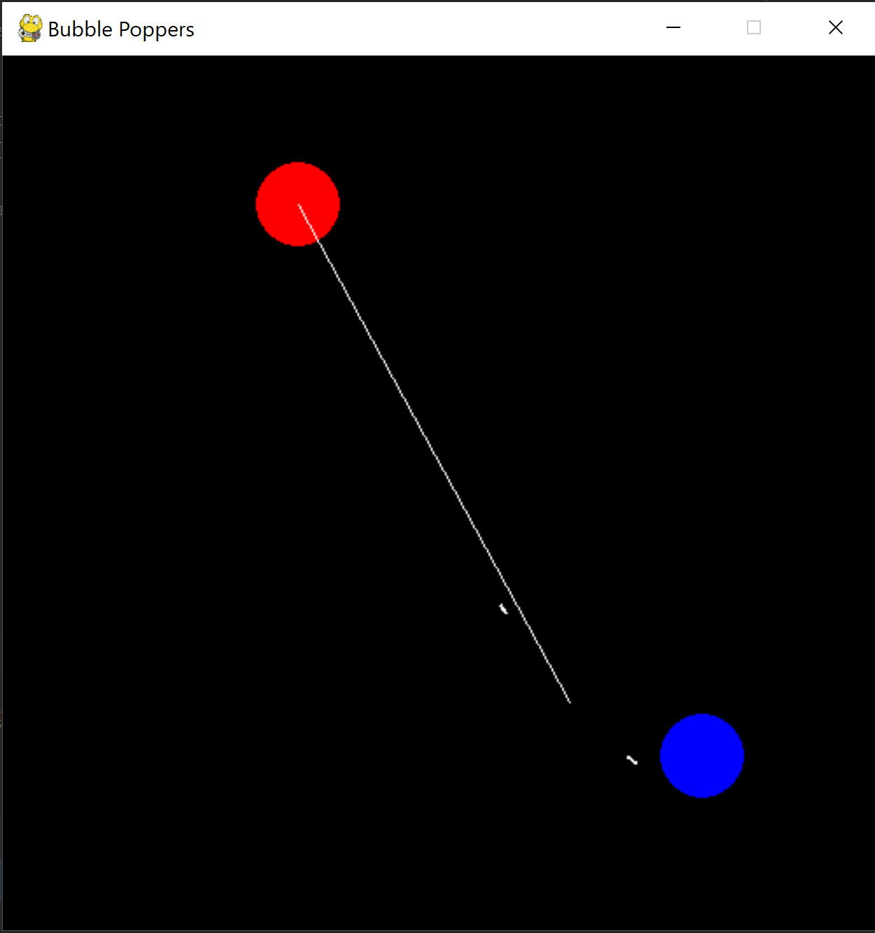

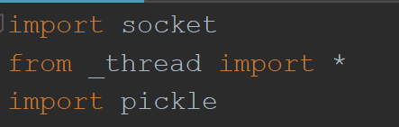
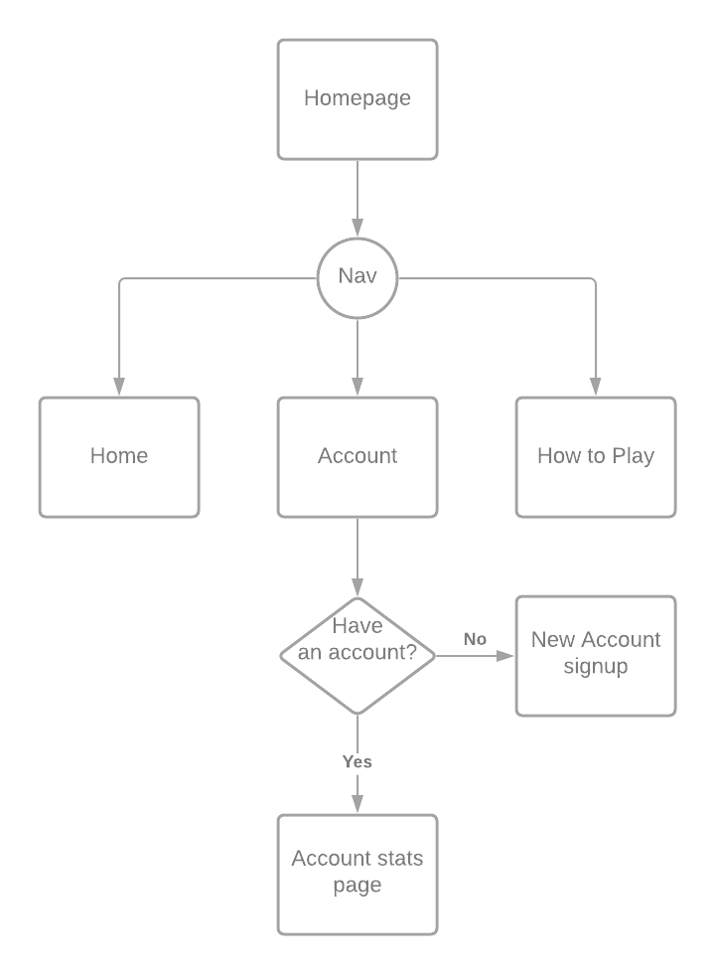


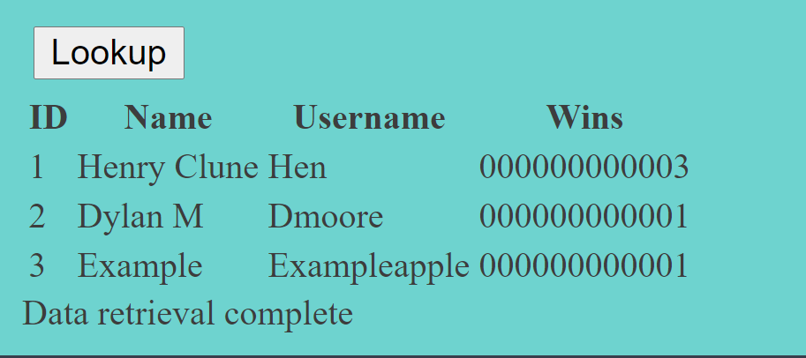
About Me
Bubble Poppers
My name is Henry Clune, I am a senior information science major with one semester left. I wanted to challenge myself with coding in a language I haven’t been formally taught, so I used python.
Create an account on the website
About the Project
Motivation
Run the Server and Play the Game
I wanted to make a simple game that could be played over a local network and have wins recorded in a database.
Have a simple concept that I could challenge myself with, learn new libraries and modules for python, and incorporate learned SQL and PHP.
Lessons Learned
Challenges
If you are going to make a server, ensure you set what you will parse your data as soon as possible in the project.
Sockets can be tricky at first but if you roll with the errors long enough you can usually find a solution.
The simplest solution is not always the right solution when considering future proofing your code.
Having to switch how I parsed data through my network and server to guarantee stability and functionality.
Connecting the python to my database through a connector led me to some firewall issues.
Learning and writing code for python’s pickle and socket libraries took me a while to understand fully.
Check wins on the leaderboard

